Slide 1
Final Engagement
Attack, Defense & Analysis of a Vulnerable Network
Final Analysis, December 2021

Slide 2
Table of Contents
This document contains the following resources:
Network Topology & Critical Vulnerabilities:
Azure Host Vm
Kali
Linux
Target 1
Capstone
Elk
Target 2.
Exploits Used: nmap, wpscan, WordPress
CVE-2007-3923: DDOS vulnerability when flooded with TCP SYN packets to either port 139/tcp or port 445/tcp.
CVE-2017-3818: Privilege escalation vulnerability.
Methods Used to Avoiding Detect: Profile targets by detecting WordPress version and installing Plugins.
Final Analysis, December 2021

Slide 3

Network Topology
& Critical Vulnerabilities
‹#›

Slide 4
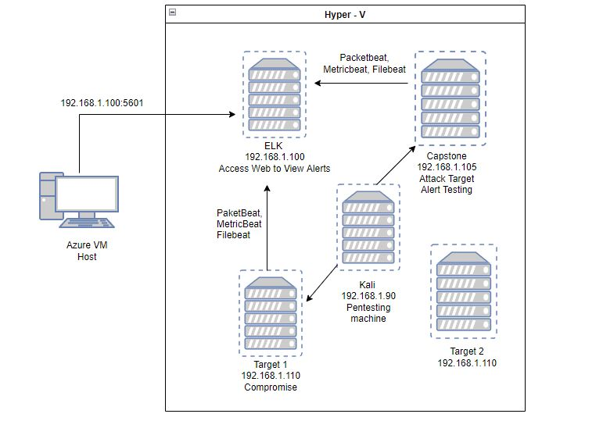
Network Topology
Network
Address Range: 192.168.100:5601
Netmask:255.255.255.0
Gateway: 192.168.1.1 dev etho onlink
Machines
IPv4: 192.168.100
OS: Linux
Hostname: Elk
IPv4: 192.168.1.90
OS: Debian Kali Linux
Hostname: Kali
IPv4: 192.168.1.110
OS: Linux
Hostname: Target 1
IPv4: 192.168.1.105
OS: Linux
Hostname: Capstone
IPv4: 192.168.1.115
OS: Linux
Hostname: Target 2
[Insert Here]
Use draw.io to create a diagram of the network.
Add your diagram to this slide and fill out the data in the sidebar.
Final Analysis, December 2021

Slide 5
Critical Vulnerabilities: Target 1
Our assessment uncovered the following critical vulnerabilities in Target 1.
Vulnerability | Description | Impact
Open Ports | Port 22, 80, 111, 139,145 | Attacker can gain access to server through these ports.
WordPress Site | Access to critical password hashes. | Exploit Vulnerabilities, Brute force attacks to obtain passwords
Weak User Password | Gain access to a user's account with a simple guess. | Easily hashed
CVE-2007-3923 | DDOS vulnerability when flooded with TCP SYN packets to either port 139/tcp or port 445/tcp. | Can cause slow run times of servers and also crashes of sites due to too much traffic.

Slide 6
Exploits Used
‹#›

Slide 7
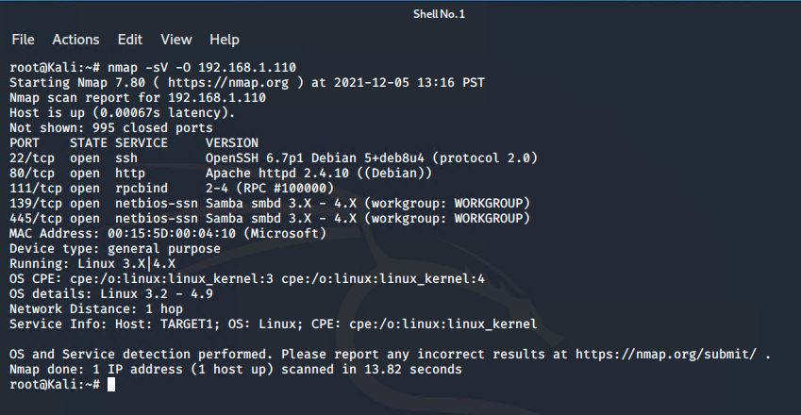
Exploitation: NMap scan of Network for Vulnerabilities
Summarize the following:
How did you exploit the vulnerability? E.g., which tool (Nmap, etc.) or technique (XSS, etc.)? nmap -sV -O 192.168.1.110
What did the exploit achieve? E.g., did it grant you a user shell, root access, etc.? Displayed all Open Ports and OS

Slide 8
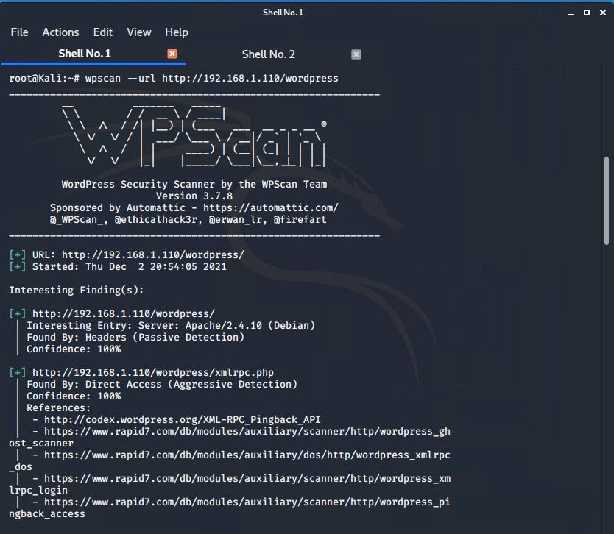
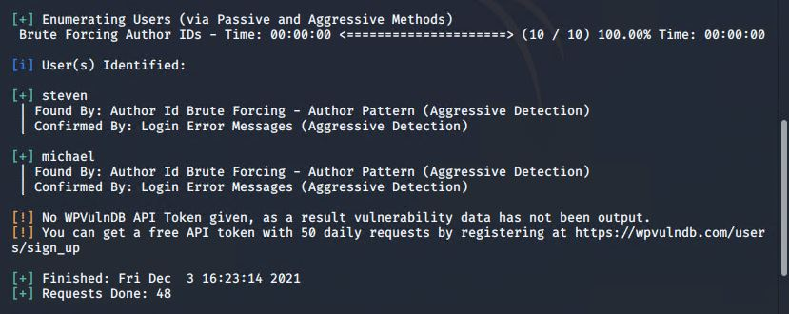
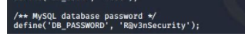
Exploitation: Exposing Users and Michael’s Password
Summarize the following:
How did you exploit the vulnerability? E.g., which tool (Nmap, etc.) or technique (XSS, etc.)? wpscan --url http://192.168.1.110/wordpress
SSH michael @192.168.110
What did the exploit achieve? E.g., did it grant you a user shell, root access, etc.? This exposed usernames, and Database password

Slide 9
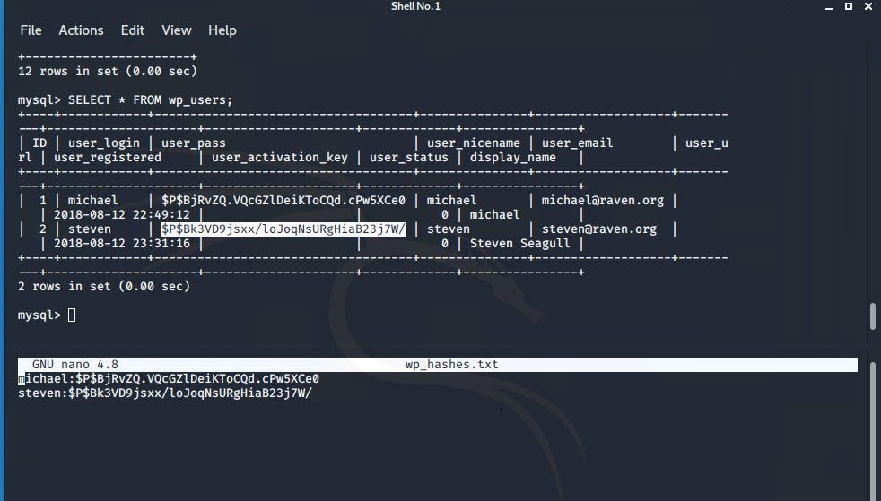
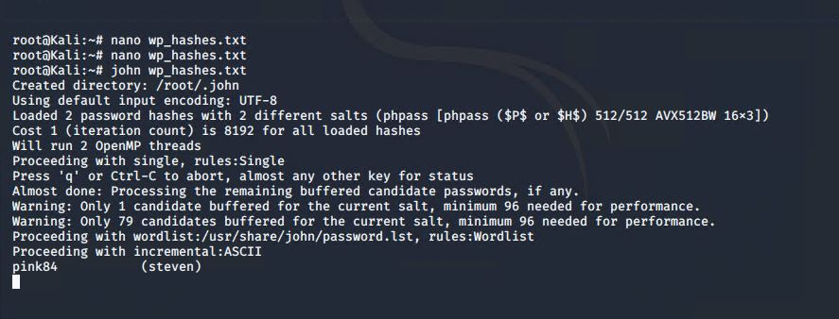
Exploitation: Finding Hashes and Steven’s Password
Summarize the following:
How did you exploit the vulnerability? E.g., which tool (Nmap, etc.) or technique (XSS, etc.)? used mysql -u root -p, mysql SELECT*FROM wp_users;
created nano file wp_users.txt with password hashes. John the ripper: john wp_hashes.txt
What did the exploit achieve? E.g., did it grant you a user shell, root access, etc.? Discovered Steven’s password of “pink84”

Slide 10
Avoiding Detection
‹#›

Slide 11
Stealth Exploitation of User Enumeration on WordPress
Monitoring Overview
Which alerts detect this exploit? Alerts that can detect brute force attacks such as Excessive HTTP Errors and unsuccessful logins can see this vulnerability.
Which metrics do they measure? Groupings of response codes for logins.
Which thresholds do they fire at? At least above 400 for the last 5 minutes.
Mitigating Detection
How can you execute the same exploit without triggering the alert? IP address spoofing to make the incoming traffic appear to be from inside the network.
Are there alternative exploits that may perform better? Rapidly escalating to root privileges before going into the file databases.

Slide 12
Stealth Exploitation of Open Ports
Monitoring Overview
Which alerts detect this exploit? HTTP Request size
Which metrics do they measure? size of HTTP request
Which thresholds do they fire at? over 3500 per 1 minute
Mitigating Detection
How can you execute the same exploit without triggering the alert? slow scan, gain access via lesser known/monitored ports
Are there alternative exploits that may perform better? vulnerability scan - search for vulnerabilities rather than guess based on exposed services/ports

Slide 13
Stealth Exploitation of Weak user passwords
Monitoring Overview
Which alerts detect this exploit? Alerts that detect failed login attempts with a threshold that allows for user error but detects any brute force attack behavior.
Which metrics do they measure? These alerts would receive information from metricbeat which monitors system data such as logins.
Which thresholds do they fire at? A good threshold to have would be above 10 in 5 minutes.
Mitigating Detection
How can you execute the same exploit without triggering the alert? With such a weak password, yes you can avoid triggering the alert. Rather than using a third party program such as hydra to attempt multiple logins in a short span maybe more research into the specific target and then manually login a few amount of times and then wait to try again.

